Slide 1
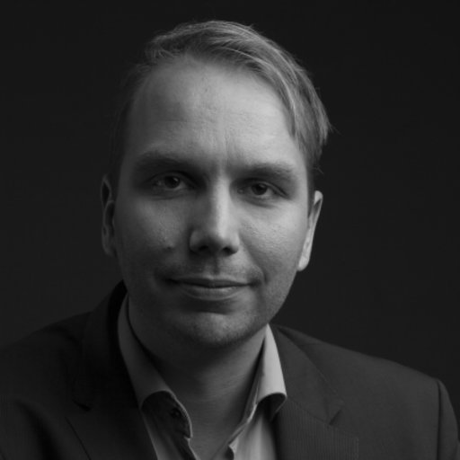

The Big Do-it-Yourself Publishing Event
Hans van Dijk
Marino van Zelst

Slide 2
The current system
Stimulates hypercompetition
Delays knowledge dissemination
Is elitist and exclusive
Relates to health epidemic in academia

Slide 3
The new system
Stimulates collaboration
Instant dissemination of research
Open and inclusive
Addresses health crisis through reduced competition and improved sense of meaning

Slide 4
